Slide 1
Unit 4
(IPR)

Slide 2
Intellectual property rights (IPR)
refers to the legal rights given to the inventor or creator to protect his invention or creation for a certain period of time. These legal rights confer an exclusive right to the inventor/creator or his assignee to fully utilize his invention/creation for a given period of time.

Slide 3
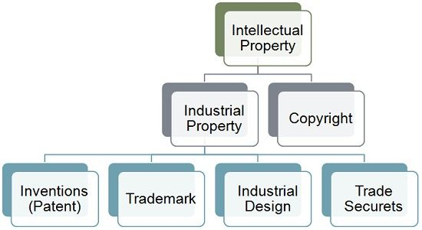

Slide 4
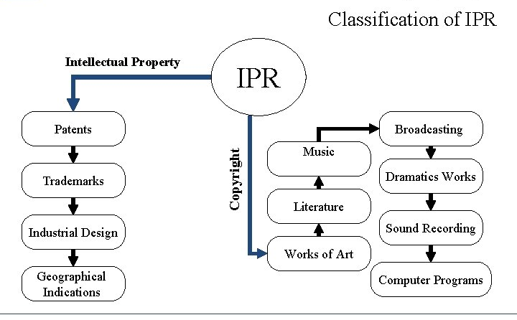

Slide 5
1. Patents:
A patent is an exclusive right granted for an invention, which is a product or a process that provides, in general, a new way of doing something, or offers a new technical solution to a problem. To get a patent, technical information about the invention must be disclosed to the public in a patent application.
Patent protection means that the invention cannot be commercially made, used, distributed, imported or sold by others without the patent owner's consent.
Patents are territorial rights. In general, the exclusive rights are only applicable in the country or region in which a patent has been filed and granted, in accordance with the law of that country or region.
The protection is granted for a limited period, generally 20 years from the filing date of the application.

Slide 6
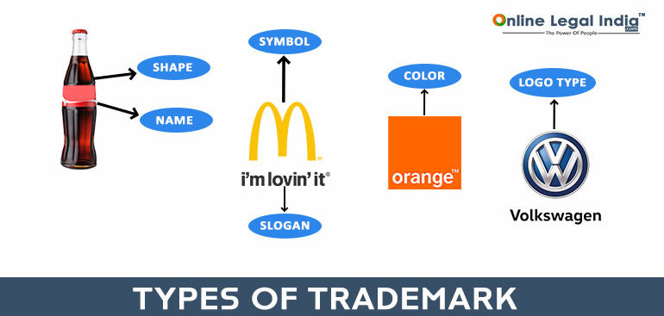

2. Trademarks
Popularly known as brand name in layman’s language, is a visual symbol which may be a word signature, name, device, label, numerals or combination of colors used by one undertaking on goods or services or other articles of commerce to distinguish it from other similar goods or services originating from a different undertaking .

Slide 7

3.Industrial design
Design means the features of shape, configuration, pattern or ornament or composition of lines or color or combination thereof applied to any article whether two dimensional or three dimensional or in both forms, by any industrial process or means, whether manual, mechanical or chemical, separate or combined .

Slide 8
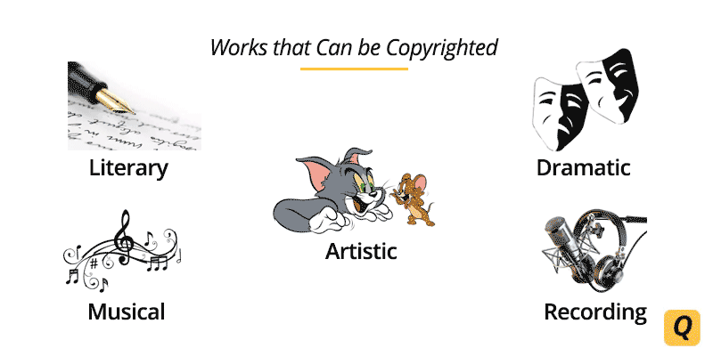
4. Copyrights
Copyright is a right given by the law to creators of literary, dramatic, musical and artistic works and producers of cinematograph films and sound recordings. It is a bundle of rights including, interalia, rights of reproduction, communication to the public, adaptation, and translation of the work

Slide 9
5.Geographical Indications
A geographical indication (GI) is a sign used on products that have a specific geographical origin and possess qualities or a reputation that are due to that origin.
Plant Varieties
To accelerate agricultural development, it is necessary to protect plants breeders’ rights to stimulate investment for research and development for the development of new plant varieties. Simultaneously, it is helpful for the seed industry to ensure availability of high quality of seeds to the farmers

Slide 10
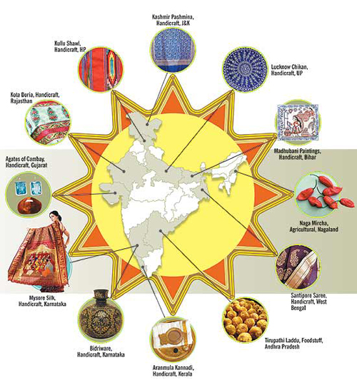

Slide 11
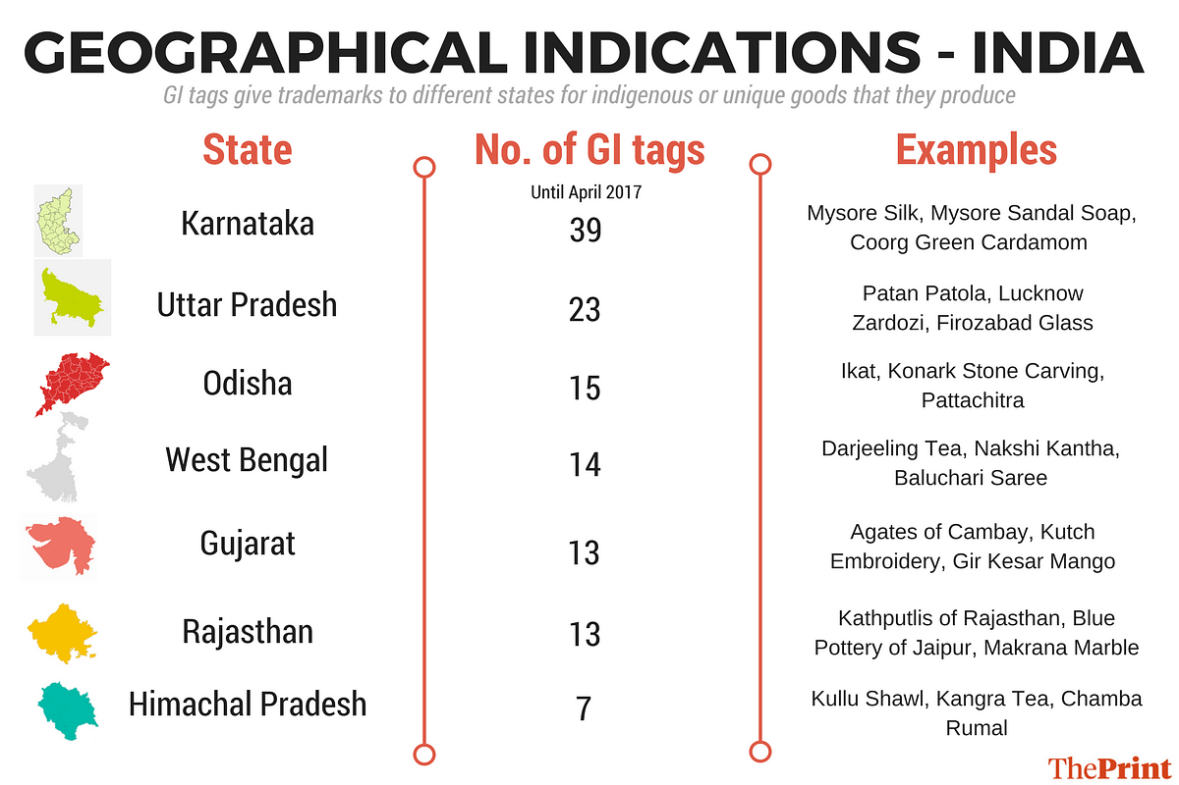

Slide 12
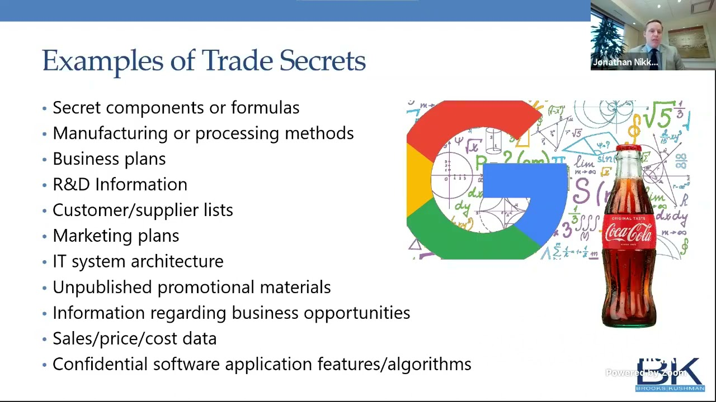

Slide 13
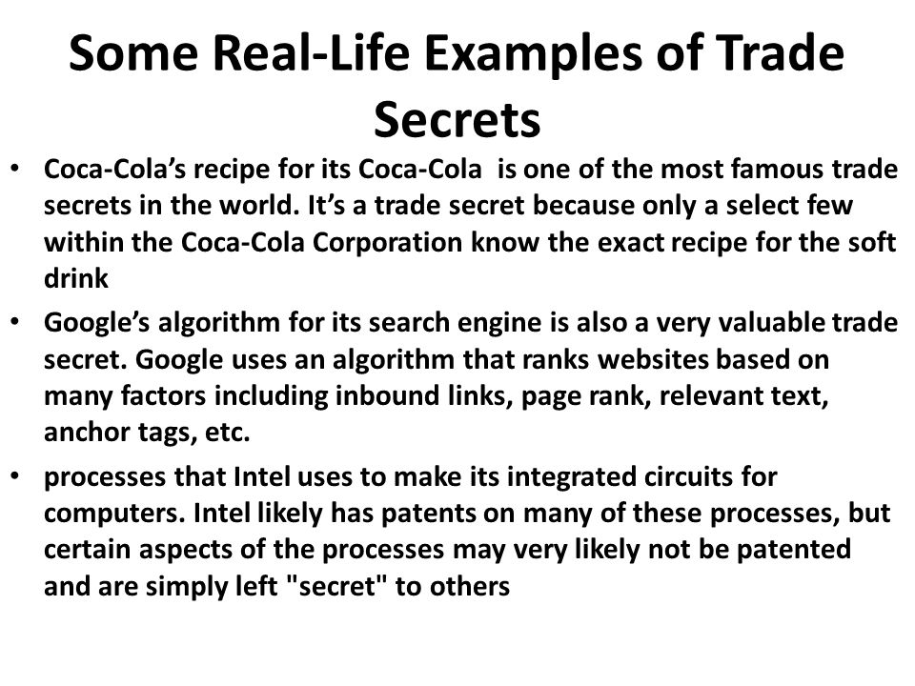

Slide 14
Property
The term property includes all the legal rights of a person. That is to say that it includes complete ownership of a man on material as well as incorporeal things.
(i) Corporeal Property has a tangible (that can be clearly seen to exist )existence in the world and is related to material things such as land, house, ornaments, silver, etc.
(ii) Incorporeal Property is intangible because it's existence is neither visible nor tangible.

Slide 15
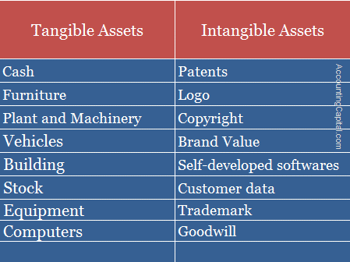

Slide 16
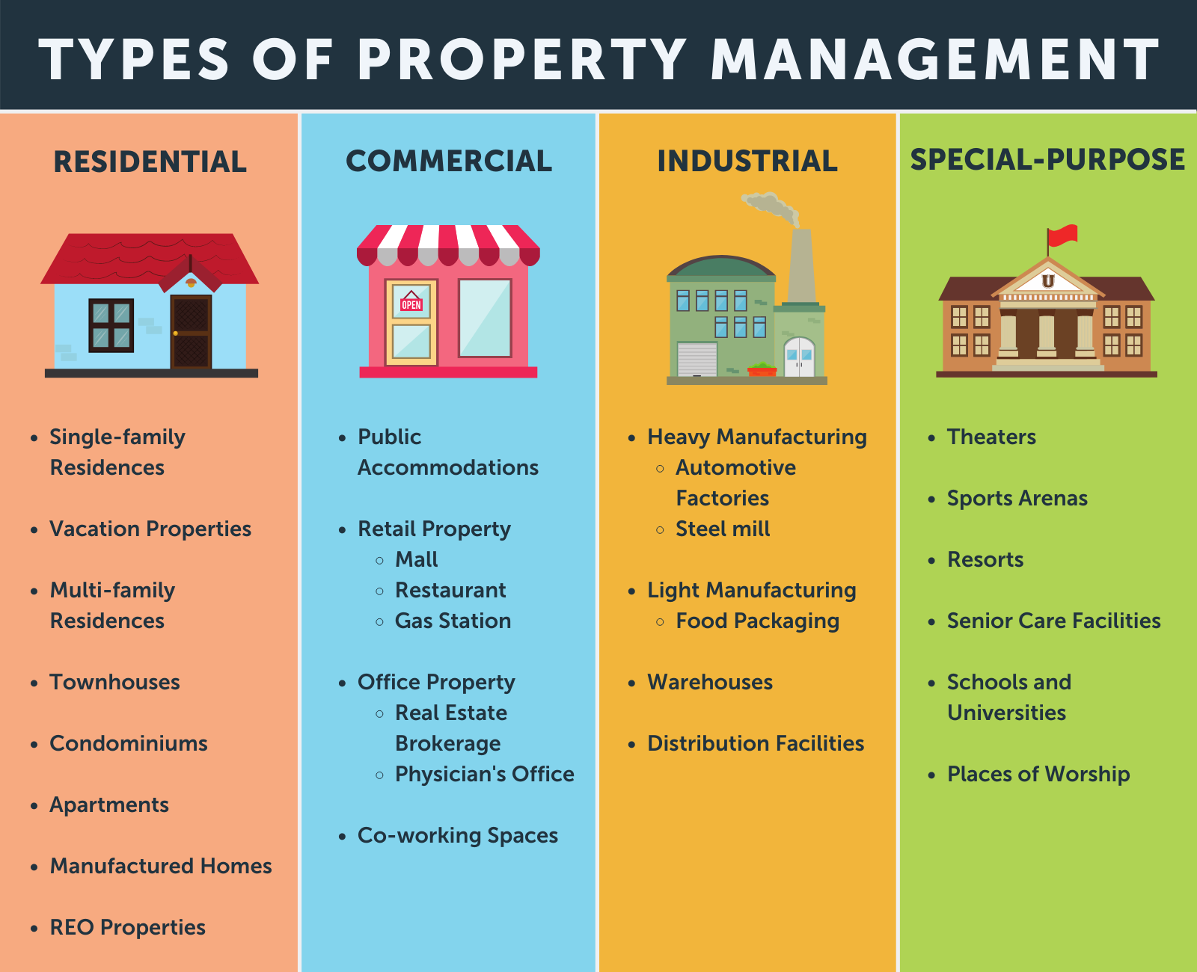

Slide 17
Trade Related Aspects of Intellectual Property Rights (TRIPS)
is an international legal agreement between all the member nations of the World Trade Organization (WTO). It establishes minimum standards for the regulation by national governments of different forms of intellectual property (IP) as applied to nationals of other WTO member nations

Slide 18
Trade Related Aspects of Intellectual Property Right (TRIPS) is an agreement on international IP rights.
TRIPS came into force in 1995, as part of the agreement that established the World Trade Organisation (WTO).
TRIPS establishes minimum standards for the availability, scope, and use of seven forms of intellectual property namely, trademarks, copyrights, geographical indications, patents, industrial designs, layout designs for integrated circuits, and undisclosed information or trade secrets.
It applies basic international trade principles regarding intellectual property to member states.
It is applicable to all WTO members.

Slide 19
TRIPS Agreement lays down the permissible exceptions and limitations for balancing the interests of intellectual property with the interests of public health and economic development.
TRIPS is the most comprehensive international agreement on IP and it has a major role in enabling trade in creativity and knowledge, in resolving trade disputes over intellectual property, and in assuring WTO members the latitude to achieve their domestic policy objectives.
It frames the IP system in terms of innovation, technology transfer and public welfare.
The TRIPS Council is responsible for administering and monitoring the operation of the TRIPS Agreement.
TRIPS was negotiated during the Uruguay Round of the General Agreement on Tariffs and Trade (GATT) in 1986–1994.
The TRIPS Agreement is also described as a “Berne and Paris-plus” Agreement.

Slide 20
Trademark | Patent | Copyright
Any word, phrase, symbol or design that recognizes and differentiates the source of one party's goods from those of another. | Inventions, such as procedure, manufacturer, composition, machines of matter as well as improvements to these. | Books, articles, music, photography, sculptures, dances, sound recordings, motion films and other original works of authorship.
A mark must be distinguishable, in the sense that it must be able to identify the source of a certain good. | A fresh, valuable, and unusual invention is required. | A work must be unique, original, and created in a tangible manner.
As long as the mark is used in commerce. | 20 years | Author’s life span 70 years.
Right to use the mark and to prohibit others from using identical marks in a way that could create confusion about the goods or services' origin. | Right to restrict others from manufacturing, selling, or importing the patented invention. | Copyrighted works have the power to dictate their reproduction, creative works, circulation, public performance, and display.

Slide 21
Invention has to be of industrial use in order to be patentable. But if the use of invention is contrary to public order or morality or which causes serious danger to human, animal or plant life or health or to the environment, such invention is not patentable.13-Jan-2020

Slide 22
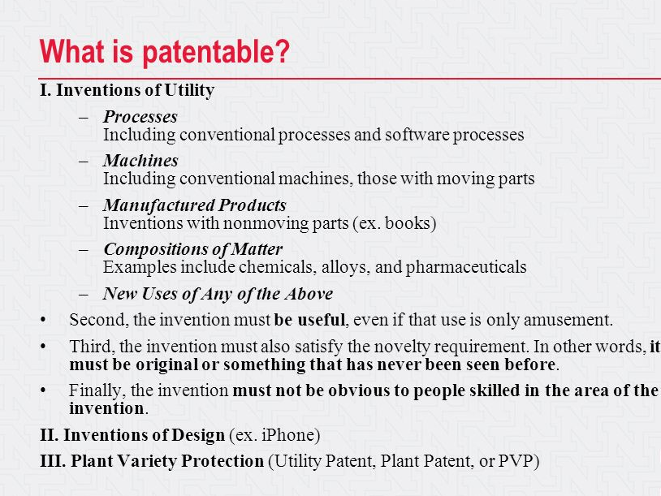

Slide 23
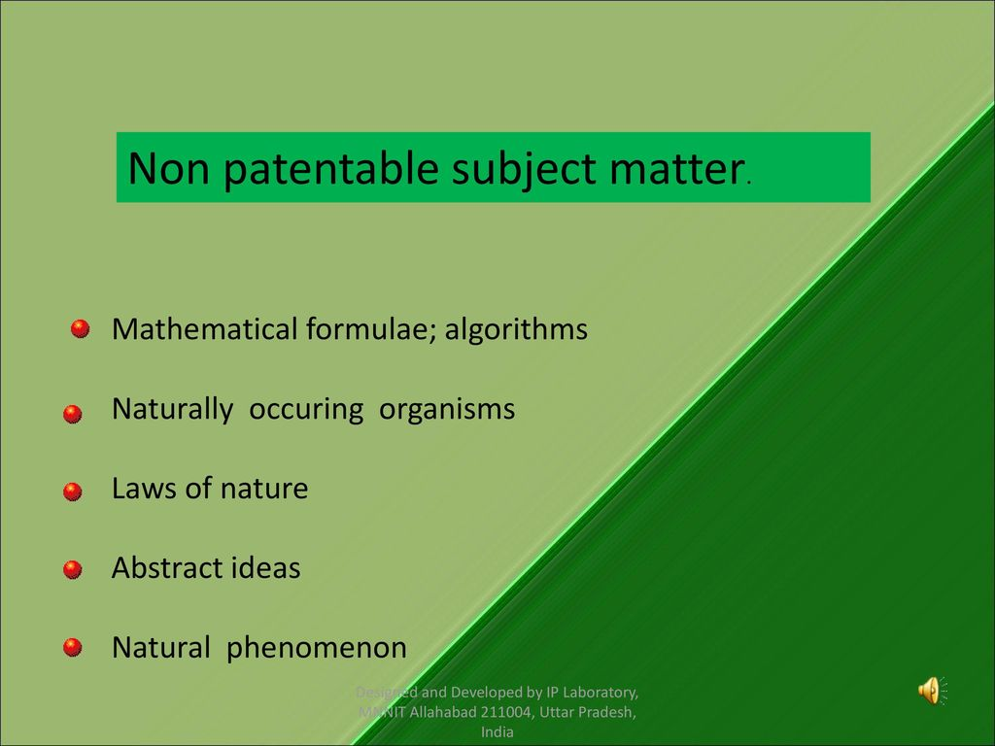

Slide 24
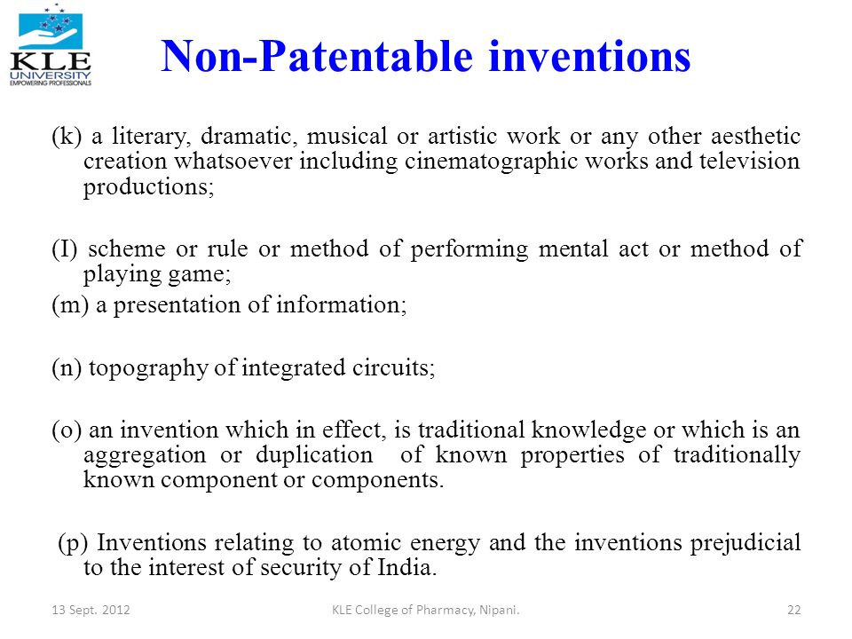

Slide 25
Process of Patenting
• Be curious but do not disclose your invention
• Keep a bound notebook to prove when you got the idea
• Develop the idea and produce a model
• Write why your invention is needed, what the existing products are in the market, your new product, and what is unique about your product

Slide 26
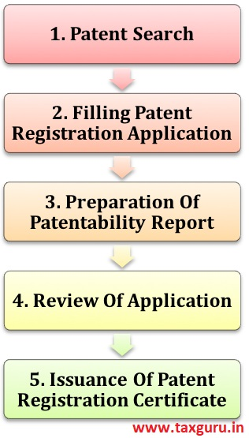

Slide 27
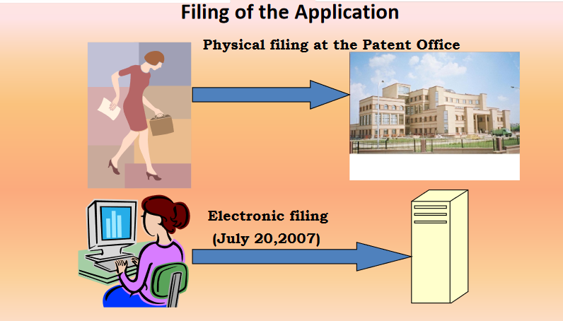

Slide 28
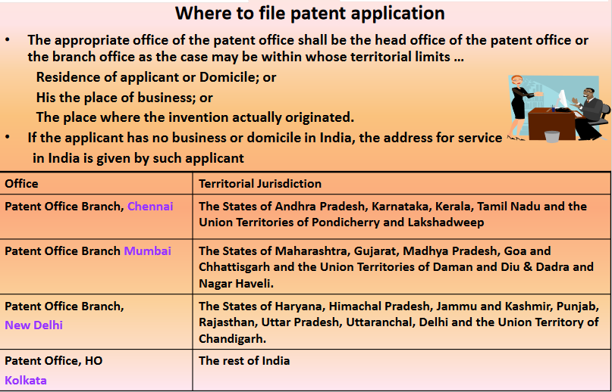

Slide 29
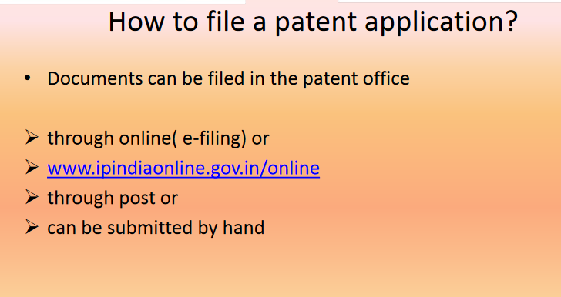

Slide 30
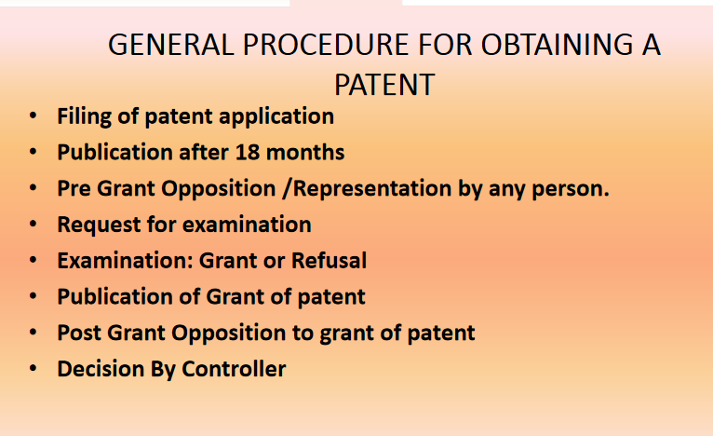

Slide 31
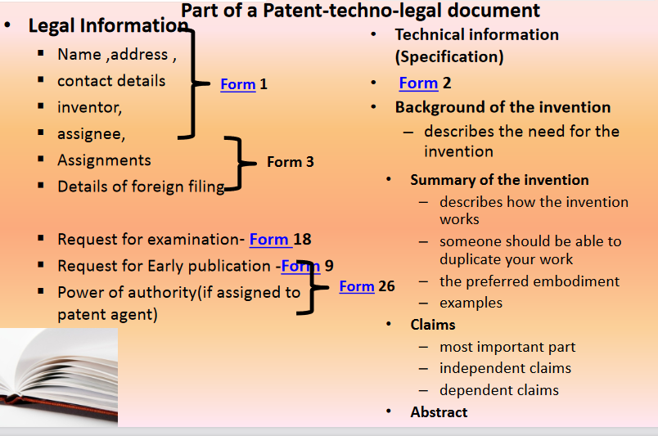

Slide 32
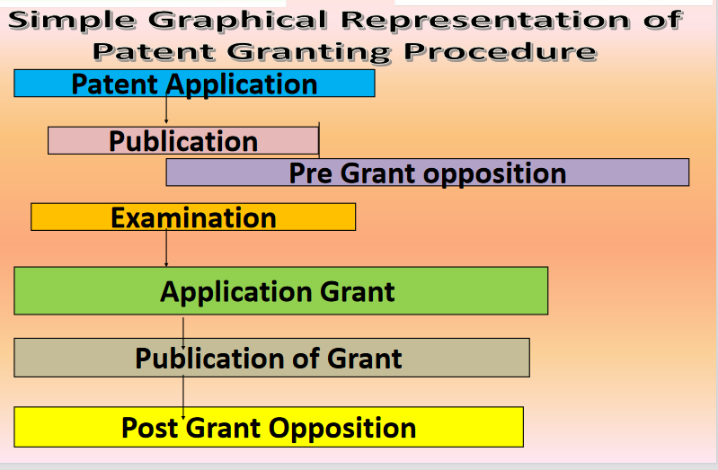

Slide 33
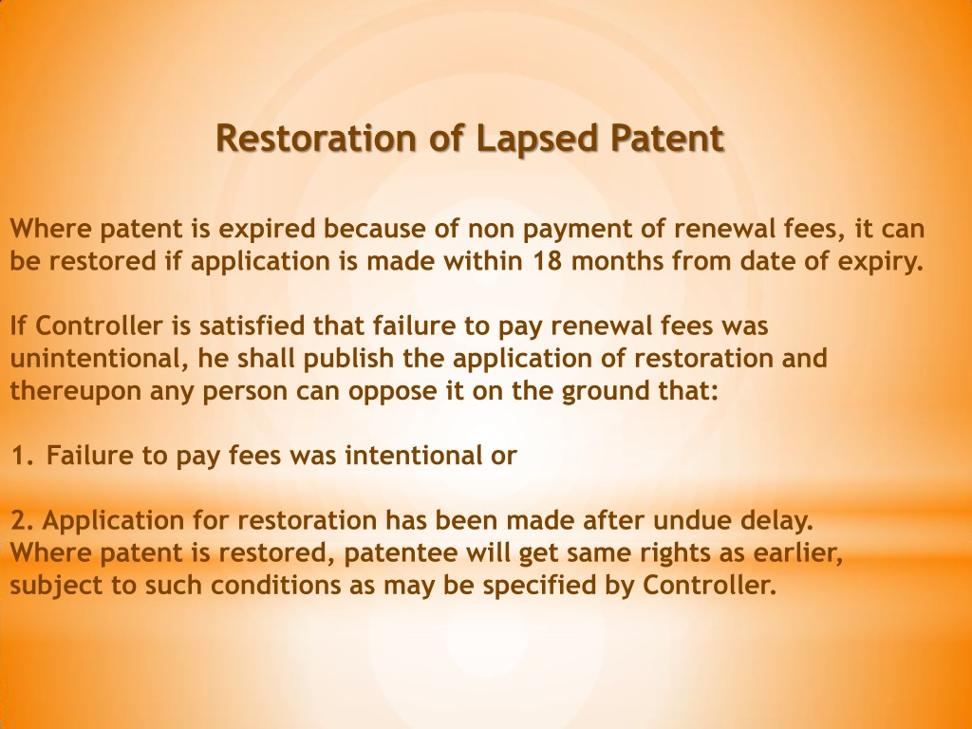

Slide 34
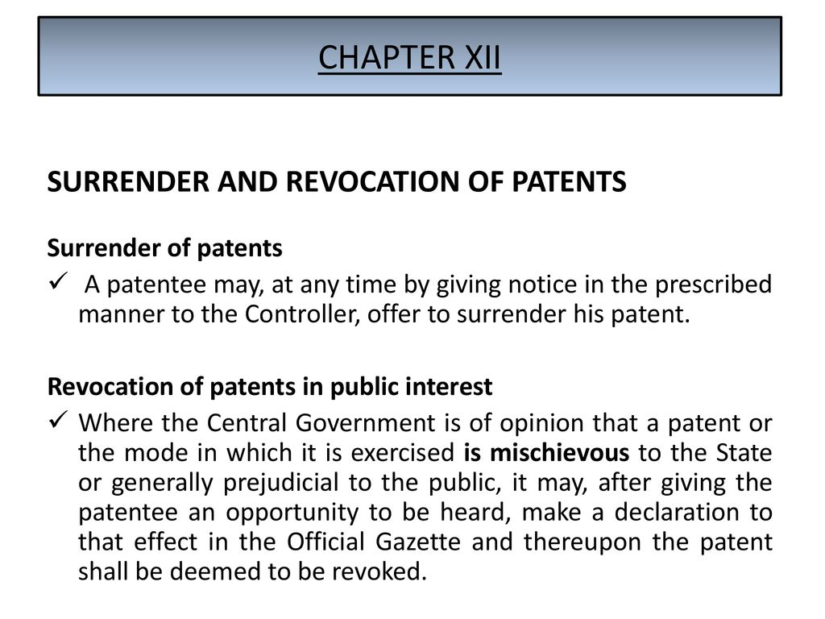

Slide 36
Patent infringement is the commission of a prohibited act with respect to a patented invention without permission from the patent holder. Permission may typically be granted in the form of a license.
Patent infringement is violation of a patentee's rights and different types of infringements have to be defended differently. Sometimes it is critical to understand the scope and meaning of the claims in the patent, because those will establish the protection an invention receives under the law

Slide 37
Types of Patent Infringement
Direct infringement: Direct infringement is the most apparent and common type of infringement. This infringement includes marketing, sale or commercial use of a similar patented item or invention that performs substantially identical functions.
Direct infringement is of two types - literal and nonliteral.
(a) Literal infringement (Willful infringement )occurs when every component in the patent specification has been used in the alleged infringing product/ device or process.
(b) Non-literal infringement(Doctrine of Equivalents Infringement) occurs when the infringing device or process may be similar or equivalent to the claimed invention (performs substantially the same function, in substantially the same way and to achieve substantially the same result.

Slide 38
B. Indirect infringement is when the infringement has happened, however the infringement is facilitated by someone else. Indirect infringements are of two types:
Inducted infringement – where one actively induces the other person to infringe a patent by encouraging, assisting, aiding, inducing him/her to do so. Patent infringement by inducement typically means that the inducer willingly and knowingly aided in the infringement but may or may not have specifically intended to violate a patent infringement.;
Contributory infringement – where there is an intentional participation/assistance by one party in an act of infringement to the other party making them vicariously liable for the acts of the infringer.

